Slide 1
Airbnb Price Prediction
Predicting Apartment Prices
Presented by :
Yixiao Pan (Peter
JinRong Qiu
Ming Lin
Shyam Patel

Slide 2
Agenda
Overview of the Problem
01
02
03
04
Importance of Problem
Data Description
Methods and Results
Conclusion

Slide 3
Problem Statement
Inputs
Outputs
Features such as Accommodations, Location, #ofRooms
Price of the AirBnB
Input 1
Output 1
Input 2
Output 2
Input 3
Output 3
Notes:
Accommodates being the # of accomodations/amenities, we removed amenities

Slide 4
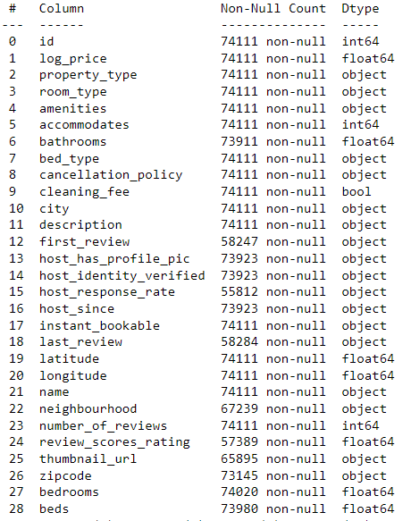
Data Collection
Data is from Kaggle
The Airbnb Price Prediction dataset was uploaded by Steve Zheng 5 Years ago
The Data Detail
The data contains 29 columns and 74111 rows

Slide 5
Data Preparation
01
Find the missing values
05
Convert data type to datetime
Preparation
["last_review"]
["first_review"]
["host_since"]
02
Drop rows with missing values in specific columns
06
['bedrooms']
Drop features with too many unique values
03
Remove unnecessary columns
07
Convert response rate to number
['id', 'host_identity_verified', 'name', 'description', 'thumbnail_url']
04
Remove duplicate rows
08
Replace missing value for host_has_profile_pic with (‘f’)

Slide 6
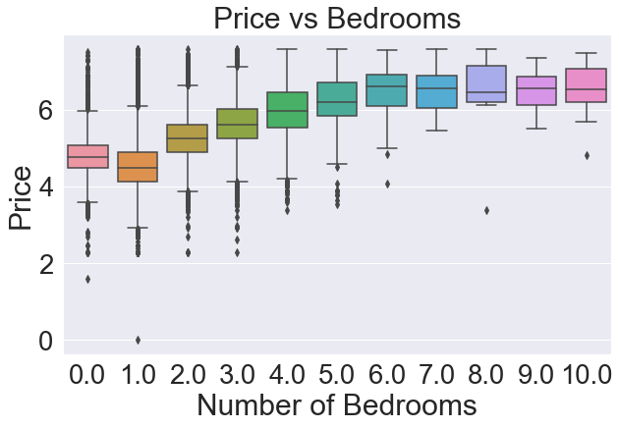
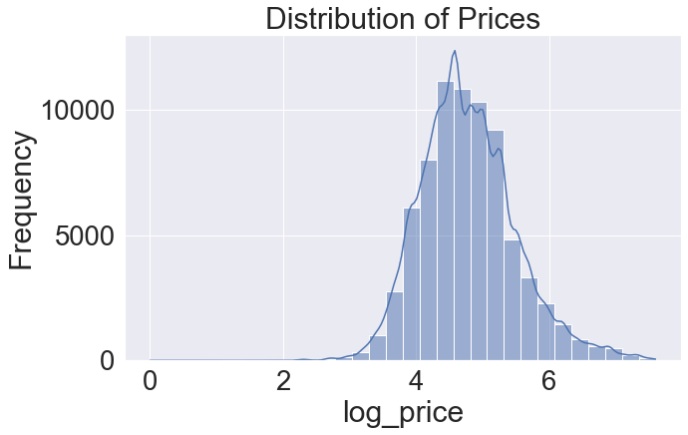
Visualize the data

Slide 7
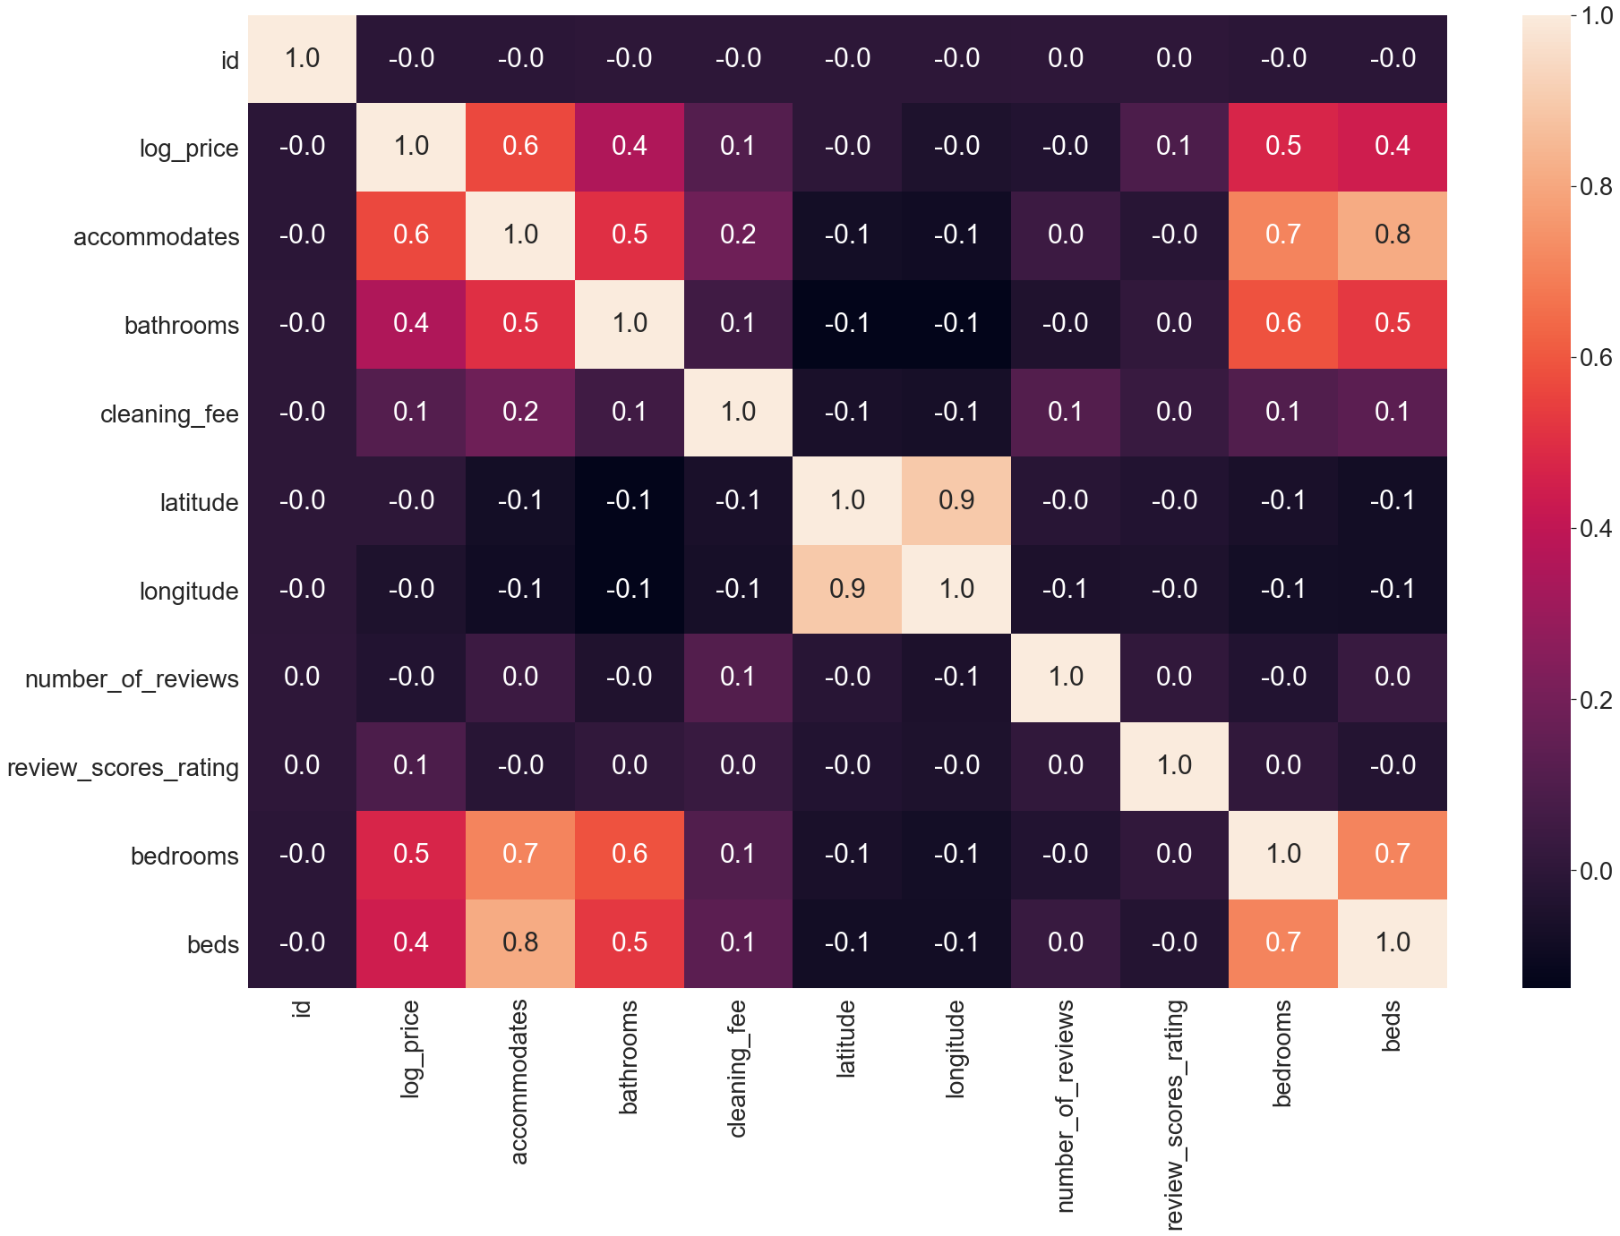
Heat Map
Correlation between numerical features.

Slide 8
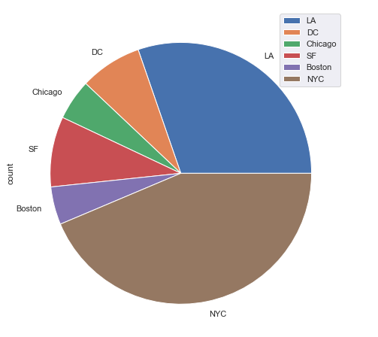
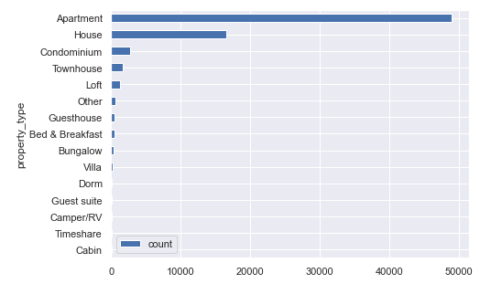
Data Visualization: Frequency Of Accomodations
Notes:
Our dataset include DC, Chicago, SF, Boston, NYC, and LA, and most of samples are from NYC and LA.
Almost all samples are apartment and House

Slide 9
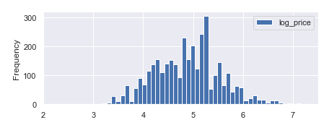
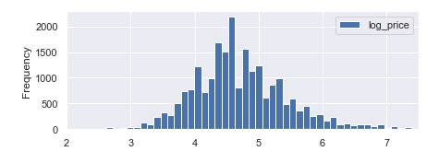
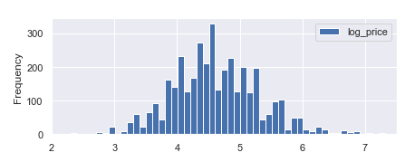
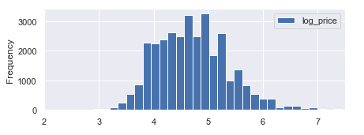
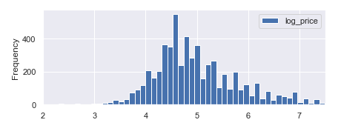
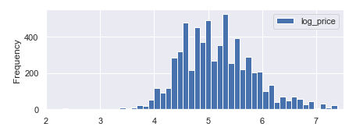
Data Visualization - Price Distribution Across Cities
Boston
Los Angeles
Chicago
New York City
Washington D.C.
San Francisco
Notes:
We could see Chicago and LA seems like normal distribution and for nyc, sf, and dc have right tail.

Slide 10
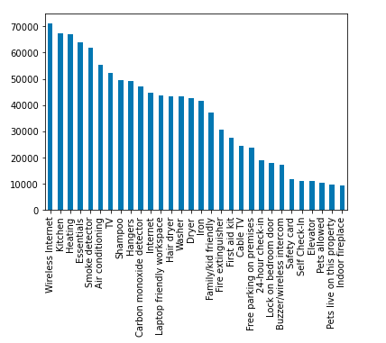
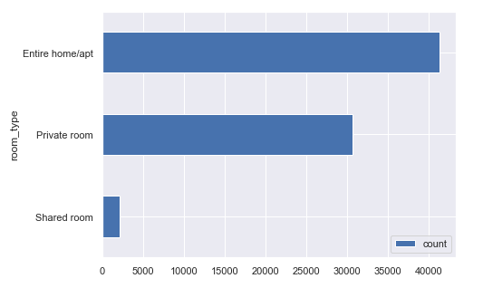
Amenity/Room Type Importance
Notes:
We break the Amenity column and count it, it shows that wireless internet, kitchen, heating are the most frequently show in house information. For the heating maybe is because the half of data were come from NYC, Chicago and DC which have long winter during a year.
As for room type, most house on Airbnb is entire home/apt and private room.

Slide 11
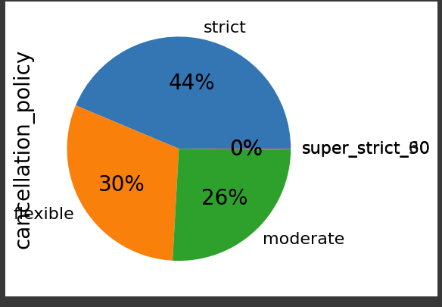
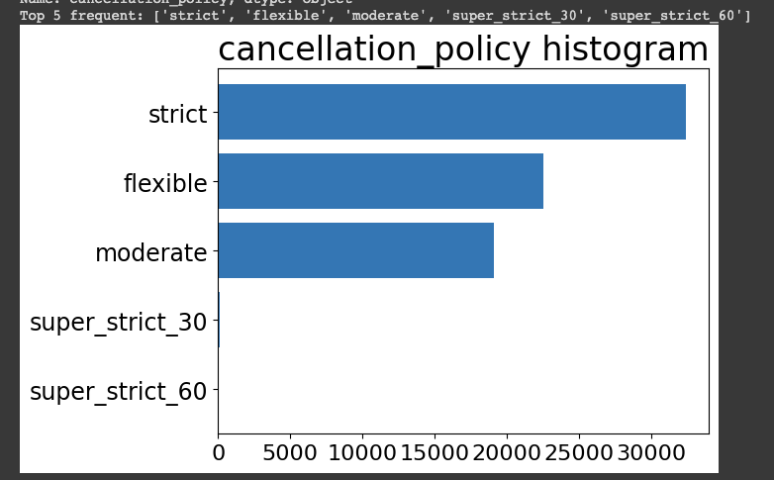
Cancellation Policy:

Slide 12
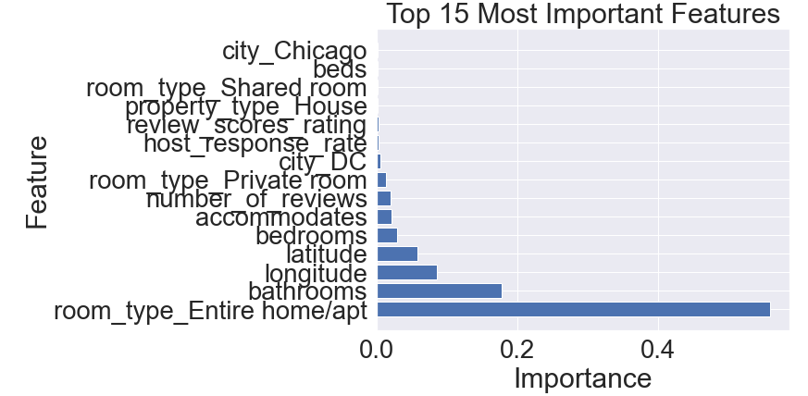
Feature Importance: Random Forest

Slide 13
Machine Learning Model Comparison
Linear Regression
01
02
Lasso Regression
MSE: 0.18
R^2: 0.65
MSE: 0.1976
R^2: 0.6164
KNN Regression
Random Forest
03
04
MSE: 0.273
R^2: 0.465
MSE: 0.183
R^2: 0.645
Decision Tree
05
06
SVM
ML for business
MSE: 0.196
R^2: 0.619
MSE: 0.183
R^2: 0.639

Slide 14
Conclusion and Q/A
Presented by :
Yixiao Pan (Peter)
JinRong Qiu
Ming Lin
Shyam Patel

